Slide 1
COMBINATIONAL CIRCUITS
COMPUTER SYSTEM ARCHITECTURE
BY:
ROSHNI PATOA

Slide 2
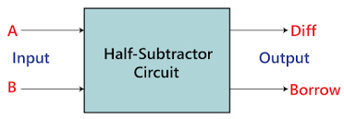
HALF SUBTRACTOR
A half subtractor is a basic digital circuit
It performs subtraction of two binary digits
Has two inputs (A and B) and two outputs (Subtract and Borrow)
Key component in arithmetic operations in computers

Slide 3
Inputs and Outputs
Inputs: Two 1-bit binary numbers (A and B)
Outputs:
Subtract (S)
Borrow (B)

Slide 4
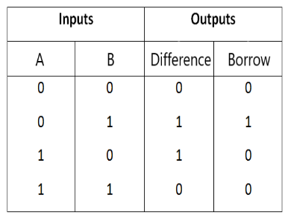
Truth Table for Half SUBTRACTOR

Slide 5
Logic Gates in Half SUBTRACTOR
XOR gate: Used for Subtract output
AND gate: Used for Borrow output

Slide 6
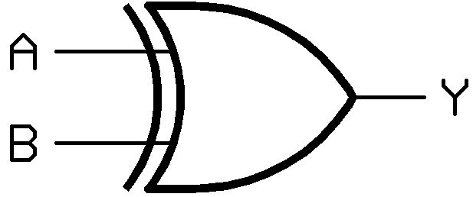
XOR GATE FOR SUBTRACT
XOR (Exclusive OR) gate used for Subtract
Output is 1 if inputs are different
Output is 0 if inputs are same

Slide 7

AND GATE FOR BORROW
AND gate used for Borrow
Output is 1 only when both inputs are 1

Slide 8
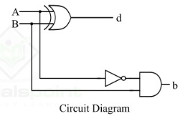
Half SUBTRACTOR Circuit Diagram
Inputs: A and B
XOR gate connected to both inputs, output is Sub
AND gate connected to both inputs, output is Borrow

Slide 9
Example: SUBTRACTING 0 - 0
Input A = 0, Input B = 0
XOR gate: 0 ⊕ 0 = 0 (Sub)
AND gate: 0’ • 0 = 0 (Borrow)
Result: Sub = 0, Borrow = 0

Slide 10
Example: SUBTRACTING 0 - 1
Input A = 0, Input B = 1
XOR gate: 0 ⊕ 1 = 1 (Sub)
AND gate: 0’ • 1 = 1 (Borrow)
Result: Sub = 1, Borrow = 1

Slide 11
Example: SUBTRACTING 1 - 0
Input A = 1, Input B = 0
XOR gate: 1 ⊕ 0 = 1 (Sub)
AND gate: 1’ • 0 = 0 (Borrow)
Result: Sub = 1, Borrow = 0

Slide 12
Example: SUBTRACTING 1 - 1
Input A = 1, Input B = 1
XOR gate: 1 ⊕ 1 = 0 (Sub)
AND gate: 1 ‘• 1 = 0 (Borrow)
Result: Sub = 0, Borrow = 0

Slide 13
CONCLUSION
Half subtractors are fundamental to digital arithmetic
They combine XOR and AND gates for binary subtraction
Next steps: Explore full subtractors

